Slide 1
Advanced higher Graphic communication
Built Environment – Creators and Users

Slide 2
Learning intentions & success criteria
Learning Intentions
Overview of the creators and users of different graphic types related to the built environment
Success Criteria
Remember the roles of different creators and users.
State the graphic types and technologies used by the creators and users.

Slide 3
Creator 1 Architects
Graphic types required:
Drawings of buildings that adhere to planning and building regulations and inform/instruct construction.
Producing orthographic drawings using 2D CAD software (AutoCAD, Vector Works) including plans, sections, elevations and technical details at different scales (1:1250, 1:200, 1:100, 1:50, 1:20, 1:5) to achieve building warrants, planning permission and inform construction.
3D CAD models using 3D modelling software (Sketch-Up, Revit/BIM, Rhino) to communicate what a building will look like to planners, communities, other members of the design team and clients.
3D models may also be produced to communicate the construction of a particular feature of the building i.e. non-standard windows.

Slide 4
Creator 1 Architects
Graphic Technologies required:
BIM (Building Information Modelling).
BIM is a single 3D CAD model shared and worked on by all members of the design team simultaneously form architects to engineers to suppliers and manufacturers of components like windows and doors.
BIM allows the building to be simulated as if it was in the real world, considering:
Loading (static, dynamic, wind, rain, snow etc).
The effects on the materials chosen.
The stresses on the structure.

Slide 5
User 1: Construction trades
Builders, plumbers, electricians, brick layers, joiners, roofers, landscape gardeners.
They all Interpret Architects drawings for instruction on how different parts of a building are to be constructed and from what materials i.e.
Foundations
external wall construction
internal wall positioning
positioning of windows and doors
roof constructions
energy saving features.

Slide 6
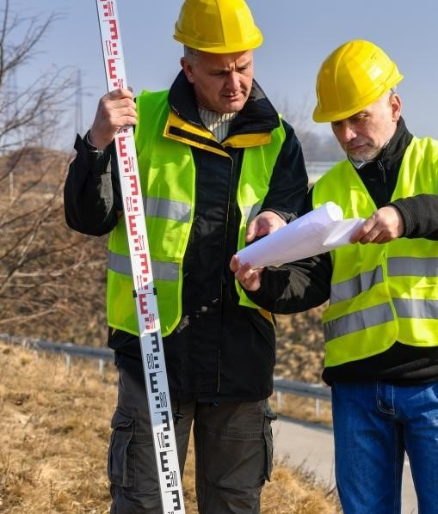
Creator 2: Building surveyors
Measures sites and buildings to give an accurate representation of existing sites and structures.
Investigate the structural condition (rot, cracks, subsidence) and fabric (water ingress, roof condition, external walls) of an existing building.
Graphic types required: measured drawings (plans and elevations) of existing building and sites prior to any design or construction.
Graphic Technologies required: Laser levels, Measuring rods, tripod, Ranging poles, Moisture meter.

Slide 7
User 2: Conservation bodies
UNESCO World Heritage, Historic Scotland. Edinburgh’s New Town is a UNESCO World Heritage site which protects the architectural heritage of the New Town. George Heriot’s School (old building) is a grade A listed building. This grading is assigned to protect the most architecturally important buildings in Scotland.
Graphic types required: historical drawings and information of some listed buildings. Mapping of an urban area and comment on its architectural character and heritage for planning consultation.

Slide 8
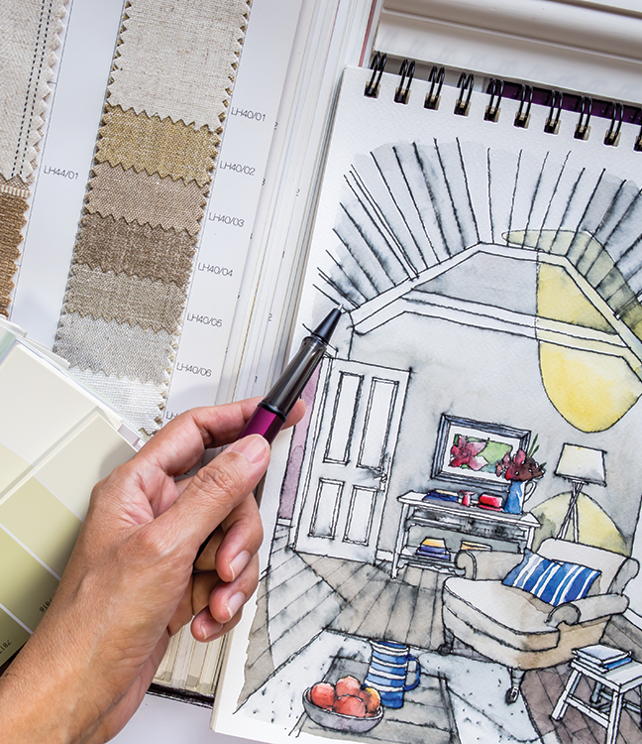
Creator 3: Interior designer
Interior design of a building, including:
Colour schemes
Tiling
Wall paper
Paintwork
Soft furnishings
Lighting.
Graphic types required:
Photoshop to edit/manipulate images and may produce 3D CAD models to generate rendered visuals to communicate the mood and style of interior spaces.
Produce materials and texture sampling and mood boards.

Slide 9
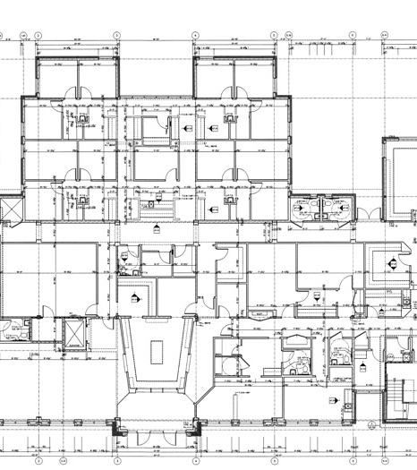
Creator 4: Production and planning
Production: detailed construction information (drawings and schedules) in order to assemble a building. Planning: the creation of Gantt charts (usually by an Architect) to plan out the stages of construction.
Graphic types required: technical detail drawings that inform construction including Location, Site and Floor Plans, sections, elevations and details at a range of scales from 1:50, 1:20 and 1:5. Planning: gantt charts are typically produced on Microsoft Excel.

Slide 10
Creator 5: Architectural Technicians
Orthographic drawings of building at varying scales from 1:200 to 1:5.
Plans and Sections that detail the construction of walls, floors and the roof and the junctions between these features.
Ensure compliance with building regulations. This means understanding the minimum size requirements for all manner of building features from disabled toilets to corridor widths to the spacing of fire dampeners in wall construction and ensuring adequate ventilation for the room. Technicians do not have any involvement with building design.
Graphic technologies required: Autodesk AutoCAD, Vector Works, poser CAD, Microstation, Building Information Modelling (BIM) e.g. Revit. BIM is a single 3D CAD model shared and worked on by all members of the design team simultaneously form architects to engineers to suppliers and manufacturers of components. The model allows information such as technical specification to be assigned to elements in the model like windows and doors. This allows schedules of items like windows to be generated directly from the model. Printer/plotter.

Slide 11
User 3: Prospective purchasers:
Potential end users of a building development who can be consulted during the design stage to influence the specification of certain elements of a project i.e. home buyer purchasing a new house ‘off-plan’ specifying what kitchen they would like.
Graphic types required: View (floor) plans, sections, elevations and rendered visuals of proposed developments.

Slide 12
Creator 6: Quantity Surveyor
Graphic Types required: highly detailed architect’s drawings to add up how much a construction project will cost.
Quantity Surveyors interpret Architect’s and Engineer’s drawings (plans, section and elevations at varying scales from 1:200 to 1:5) to price the cost of construction and produce Bills of Quantities based upon the quantity of different features of the building.
Once a construction job has been costed, a quantity surveyor will advise on how much costs can be saved. Often changes to finishes (flooring, tiling, kitchen and bathrooms), glazing and roofing is a way to save money.
Graphic Technologies required: Quantity Surveyors often receive packages of physical drawings to work from. They tend to produce Bills of Quantities, based upon the drawings they have received, on Excel spreadsheets.

Slide 13
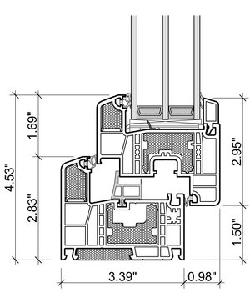
User 4: Suppliers
Graphic Types required: highly technical graphic information to communicate how their product, i.e. a window system, is manufactured and can be constructed.
3D CAD models to communicate how components fit together along with detailed 2D production drawings to inform the manufacture of their product. Will also work with Architects and engineers to design bespoke components.
Details at a scale of 1:10 to 1:2 showing how their product or system is constructed and can be installed.
Graphic Technologies required: 3D modelling and rendering software (Sketch Up, Rhino, Autodesk Revit, 3D Studio Max, Maya, Inventor and may other software packages.) 2D Drawing software (Autodesk AutoCAD, Vector Works, Microstation etc.) Files will generally be emailed between suppliers and Architects, Engineers and clients.

Slide 14
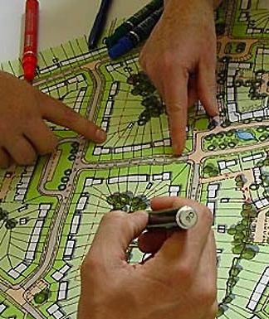
User 5: Town planners
Graphic Types required: Review Architect’s drawings including: location plans, site plans, building plans, sections and elevations and rendered visual images produced from 3D CAD models to determine the suitability of the proposed development on the given site, at 1:200 for building information. Location and site information is usually at a scale of 1:1250 or 1:500. 3D walk through animations are produced to give client of the public a more realistic impression of the intended design from a users perspective.
Graphic Technologies required: Contractors will view copies of location and site plans, sections and elevations, usually in pdf format on a planning portal website run by the local authority. For very large public developments, communities may also view full scale printed drawings and images at consultation events. Sometimes rendered images of the final building will appear on temporary security hoarding around the site during construction. A feature of major public developments is the use of 3D animated walk-through visuals to give the public a realistic feel for the interior space of the building. In major developments, physical 3D models are built in order to sell the development to the client and the public.

Slide 15
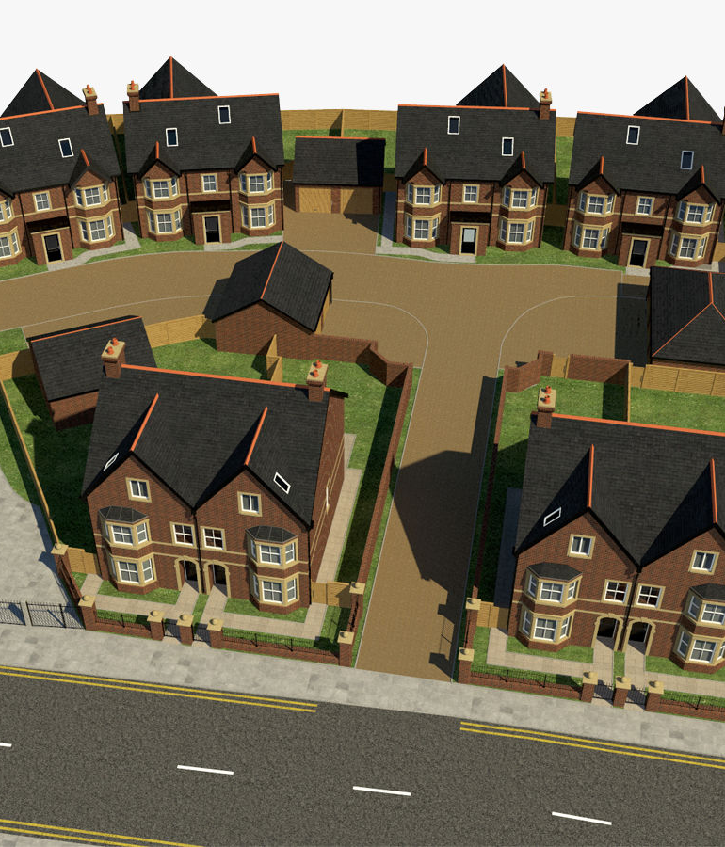
User 6: Communities
Graphic Types required: Consulted with to give input into new developments. May be invited to attend consultation events whereby developers and some members of the design team, principally architects, present drawings depicting what a new development is going to look like and how it is going to impact upon the local community. Drawings are typically those used for planning purposes (location and site plans, building plans, elevations and rendered visuals produced from 3D CAD models).
Graphic Technologies required: Will view copies of location and site plans, sections and elevations, usually in pdf format on a planning portal website run by the local authority. For very large public developments, communities may also view full scale printed drawings and images at consultation events. Sometimes rendered images of the final building will appear on temporary security hoarding around the site during construction.

Slide 16
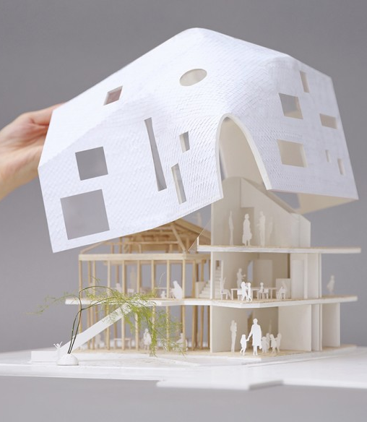
Creator 8: Model Makers
Makes physical scale models of proposed building designs which are typically made from card, wood, mount board, plastics. May also build 3D models and create physical models via rapid prototyping.
Graphic Types required: Measures plans, sections and elevations (produced by Architects) to get the correct sizes to build scale models of the proposed building.

Slide 17
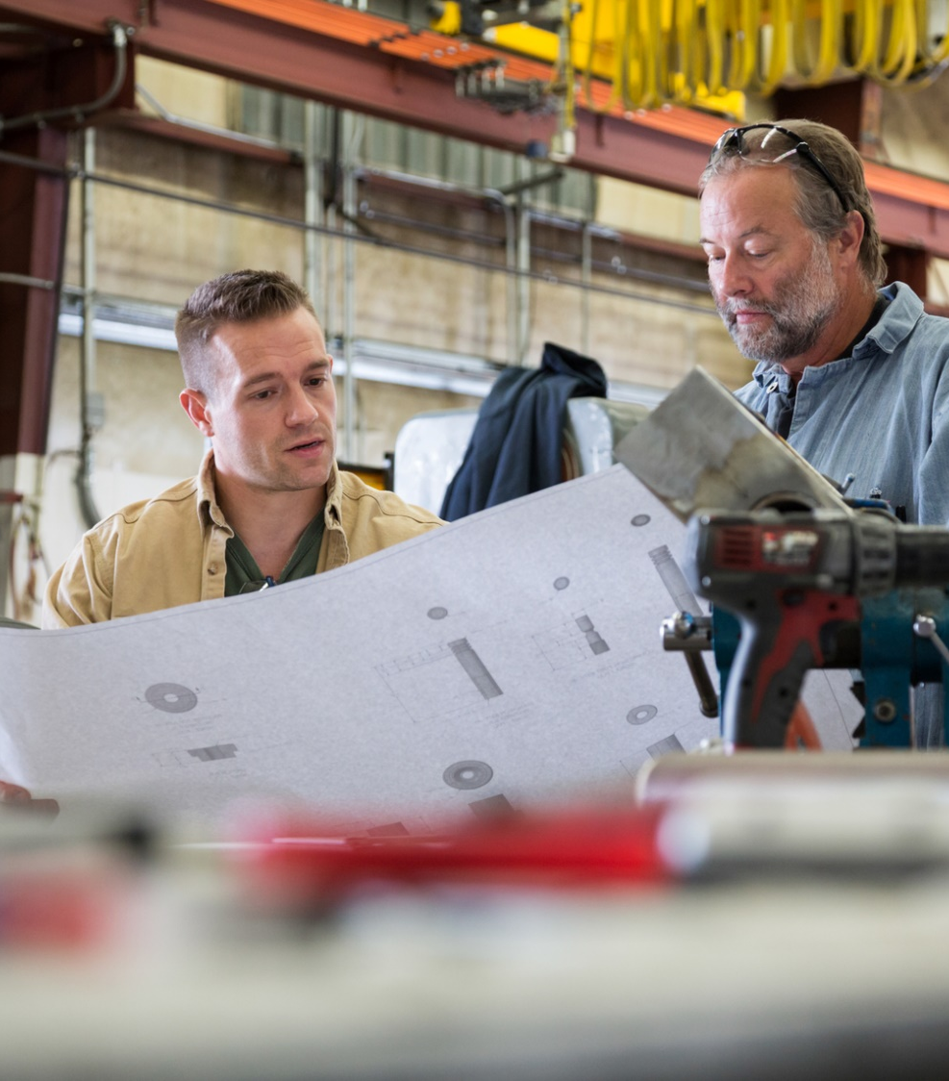
Creator 9: Production Engineer
Graphic Types required: Freehand sketches, initial computer sketches, initial computer models, 3D computer models, Manual drawings (drawing board), Orthographic drawings (assembled and parts), Technical detail drawings (sections etc), FEA Analysis, Exploded pictorial drawings, 3D prints, Animations, Flow diagrams, Parts lists, Model plans, tolerances, material details, system diagrams, operation diagrams, instruction manuals, safety signage.
Graphic Technologies required: CAD packages (2D, 3D or multifunctional), 3D printer, animation packages, graphics tablets, digital photography, tablet computers, personal computers, printed materials (books, manuals etc), industrial printers, drum plotters.
A production engineer is mainly concerned with the efficient and safe production of whatever they are manufacturing, their interaction with graphics is both in relation to the products being manufactured and also the maintenance of the machinery used. They may use digital and print media in the process of production, both for direct production reasons and also to enhance quality and efficiency of the process. They need a complete understanding of the product.

Slide 18
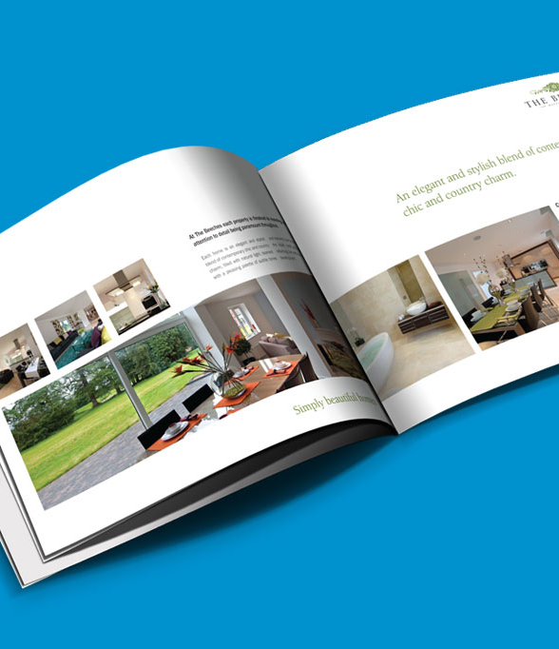
User 7: The General Public
Graphic Types required: Promotional materials such as brochures, leaflets, instructions, adverts, magazines, posters. Digital media such as Websites, digital publications, digital instructions, CD covers, DVD covers, Packaging, Logos, signage, digital applications, Digital interfaces, physical interfaces, wayfinding, animation, animated films, entertainment.
Graphic Technologies required: Tablet computers, personal computers, actual signage (vinyl, etched etc), Print media (on paper or packaging), Televisions, Digital media players, 2D interfaces (digital lecterns, phones, tablets etc), physical interfaces (from cars to coffee machines to ATM), Paint.
The General public use graphics every single day, from getting from place to place to making a phone call. Without thinking about it they interact with graphics in both simple and sophisticated ways, the general public are very aware of when graphics work and when they don’t, they understand when an interface is intuitive, they react to a well designed graphic on packaging and they can appreciate a well animated movie, the convers is also true. They may not have the technical understanding of how the graphics are generated (or car) but they have sophisticated and varied tastes.

